Slide 1
POWERPOINT PRESENTATIONS
Presentation in English

Slide 2
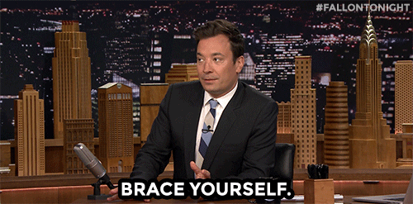
OPINION?
(Source: https://fallontonightgifs.tumblr.com/)

Slide 3

EVOLUTION

Slide 4
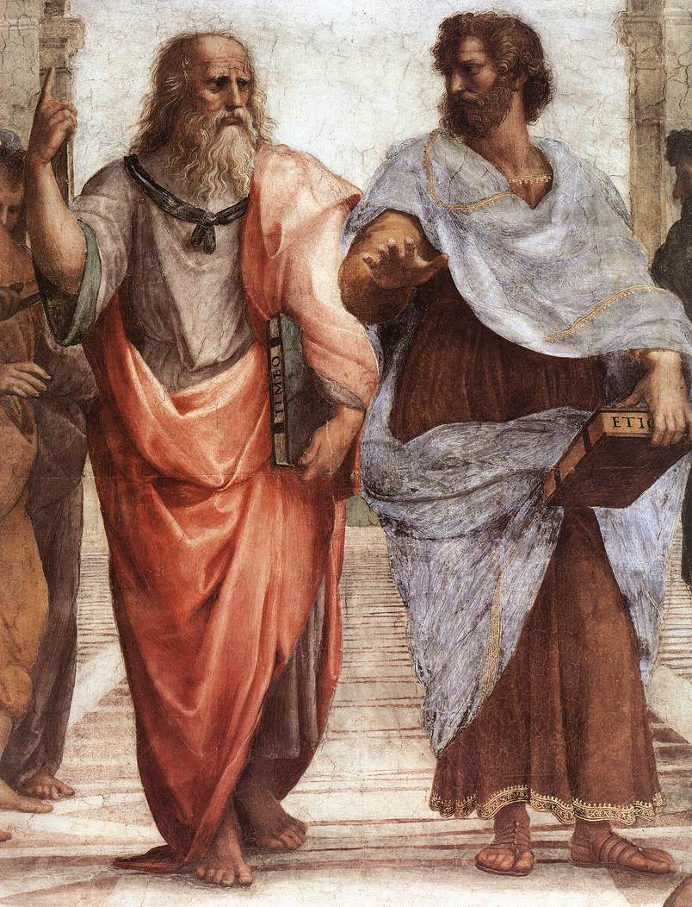
ORAL CULTURE
Detail from “School of Athens” by Raphael, Showing Plato & Aristotle

Slide 5
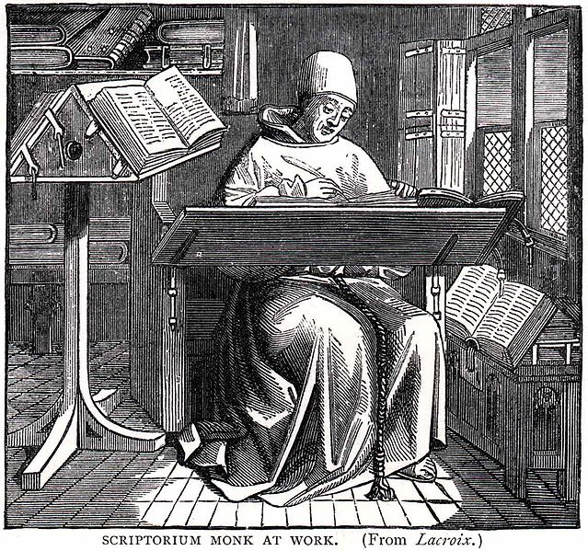
LITERATE CULTURE
“SCRIPTORIUM MONK AT WORK (From Lacroix.)” by William Blades, from Pentateuch of Printing with a Chapter on Judges (1891)

Slide 6
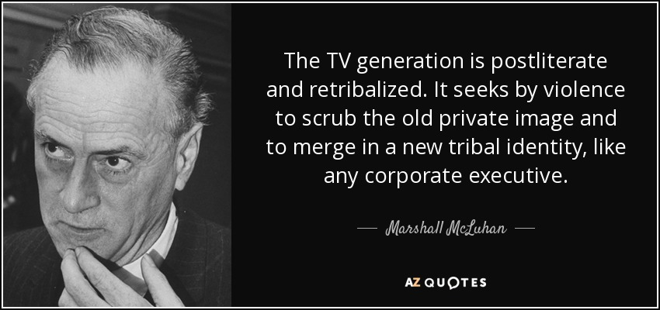
POSTLITERATE CULTURE
Source: "The Book of Probes: Marshall McLuhan". The Book of Probes : Marshall McLuhan (2011)
Designed by David Carson, edited by Marshall McLuhan project, W. Terrance Gordon, Eric McLuhan, Philip B. Meggs (page 201)

Slide 7

WHAT IS MCLUHAN SAYING?
(Source: https://fallontonightgifs.tumblr.com/)

Slide 8
POWERPOINTS SUCK*
(*usually)

Slide 9
POWERPOINTS SUCK*
(*usually)

Slide 10

HOW TO MAKE ONE
THAT DOESN’T SUCK!
From “The Mick” (Source: https://giphy.com/gifs/themick-fox-kaitlin-olson-3oriNNR3iJl6OQABzi)

Slide 11
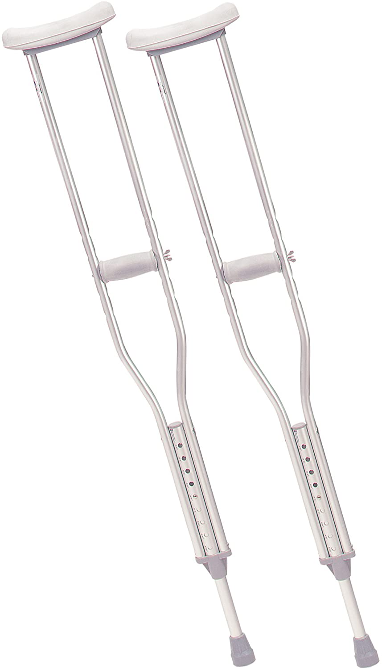

FUNCTION

Slide 12
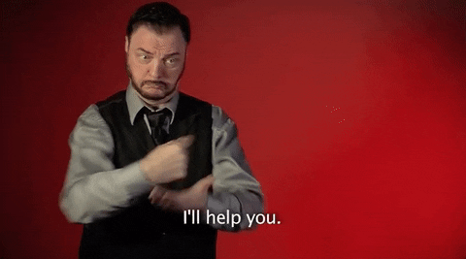
THE FOCUS IS NOT YOU,
IT’S THE AUDIENCE!
This and all other Sign by Robert gifs Source: https://giphy.com/signwithrobert/

Slide 13
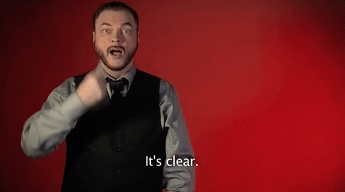
CLARITY

Slide 14
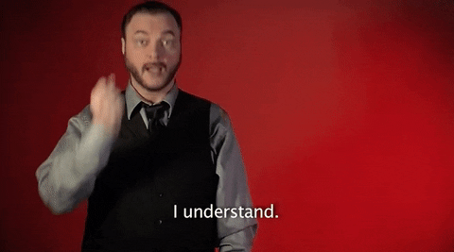
UNDERSTANDING

Slide 15
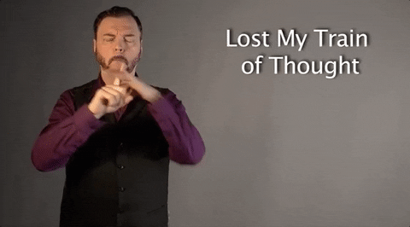
FOCUS

Slide 16
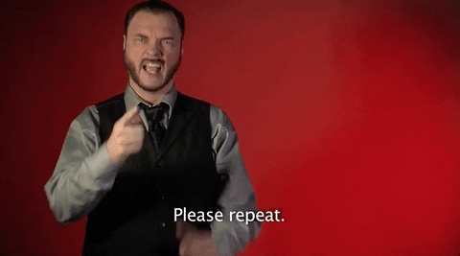
RETENTION

Slide 17
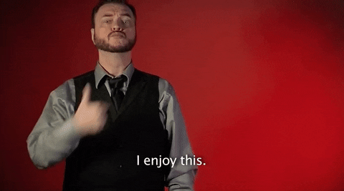
ENJOYMENT

Slide 18

AGREEMENT (MAYBE)

Slide 19

IF YOU MUST USE A POWERPOINT

Slide 20
RIGHT?
... next lecture...

Slide 21
WHAT NEXT?
(CHECK BLACKBOARD)

