Slide 1
Good/Bad Powerpoints
A Comparative Exercise

Slide 2

IF YOU MUST USE A POWERPOINT

Slide 3
AVOIDING EXCESS VERBIAGE

Slide 4
WHAT THIS POWERPOINT IS SO YOU UNDERSTAND WHAT I’M DOING HERE
This powerpoint will present an overview of some rules or guidelines that will help you make a better powerpoint slide presentation while avoiding some of the biggest and most common mistakes made by people who are tasked with including Powerpoint Slideshow to accompany a presentation.

Slide 5
PURPOSE
This slideshow will present:
rules/guidelines for good Powerpoints

Slide 6
PURPOSE
This slideshow will present:
rules/guidelines for good Powerpoints
pitfalls/problems to avoid

Slide 7
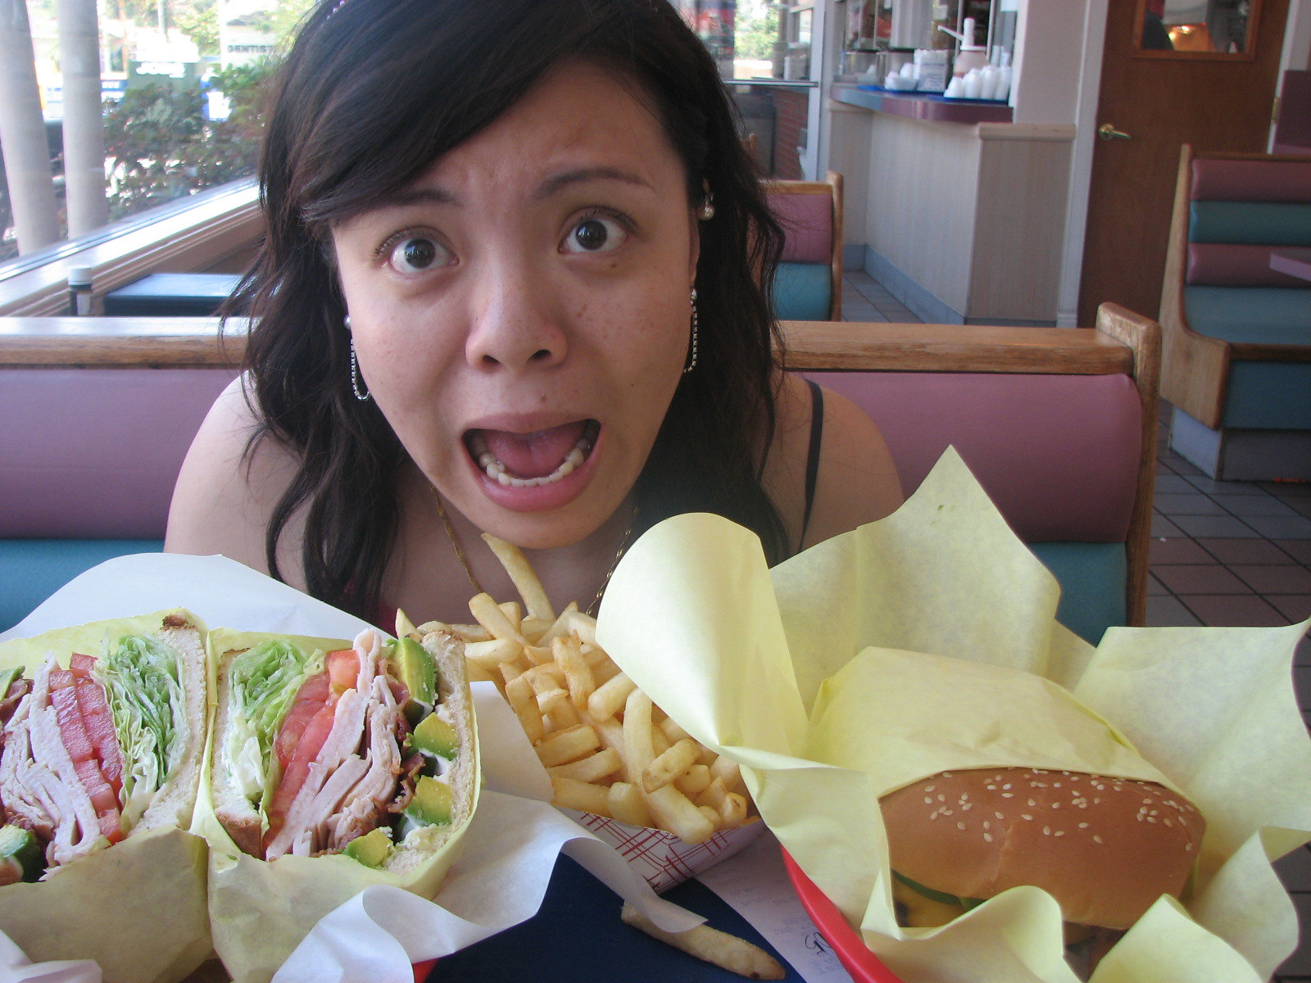
WHY?
processing limits
Image: “Too much food” by Micah Sittig. (Used under an Attribution 2.0 Generic (CC BY 2.0) license.)

Slide 8

WHY?
directing attention

Slide 9
HOW TO:
minimize text
(3-4 words or 2 phrases)
new text, new slides

Slide 10
HOW TO:
minimize text
(3-4 words or 2 phrases)
new text, new slides

Slide 11
HOW TO:
minimize text
(3-4 words or 2 phrases)
new text, new slides
focus on keywords

Slide 12
HOW TO:
minimize text
(3-4 words or 2 phrases)
new text, new slides
focus on keywords
“digestible” chunks

Slide 13
POWERING UP
YOUR POWERPOINT

Slide 14
WARNING

Slide 15
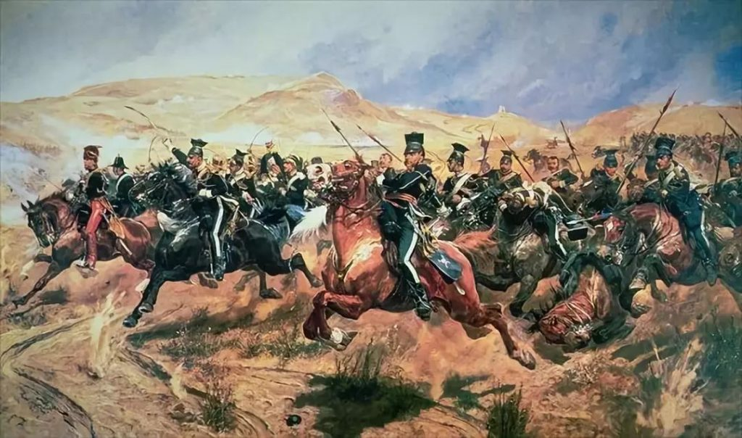
PAINTINGS (AFTER THE FACT)

Slide 16
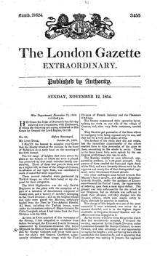
NEWS REPORTS (TEXT)

Slide 17


LITERARY TREATMENTS

Slide 18

EVEN PERSONAL COMMUNICATIONS

Slide 19
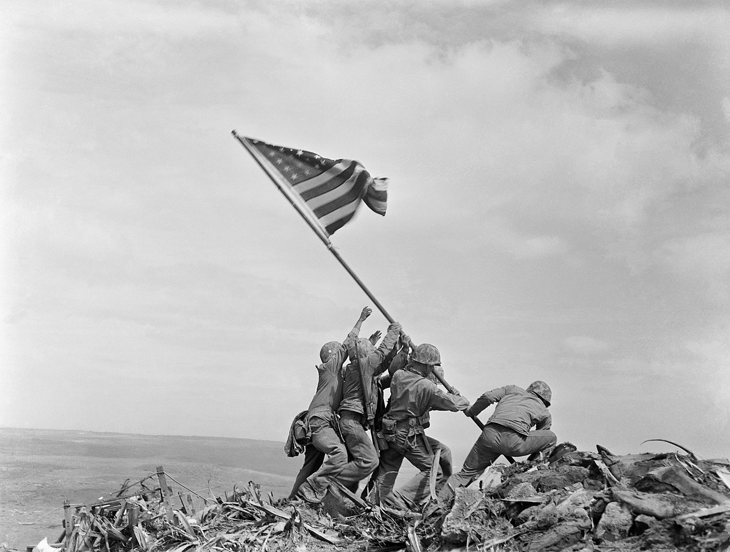
PHOTOGRAPHS
Public Domain Image: Raising the Flag on Iwo Jima, by Joe Rosenthal of the Associated Press

Slide 20
BUT THEN

Slide 21
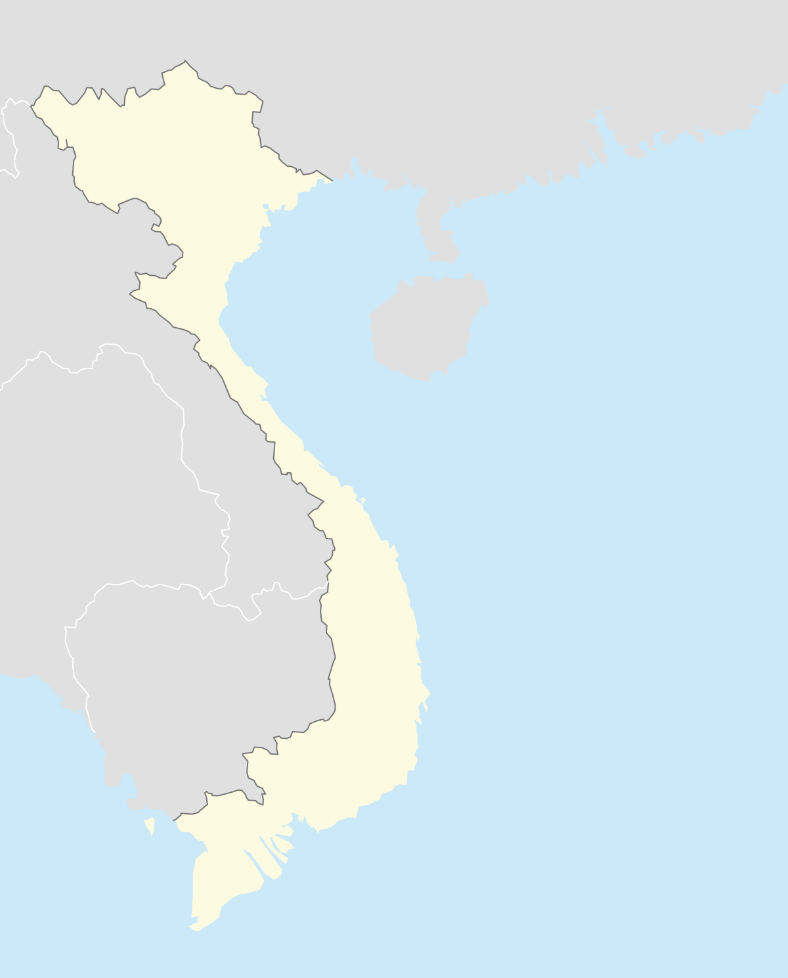
VIETNAM WAR

Slide 22
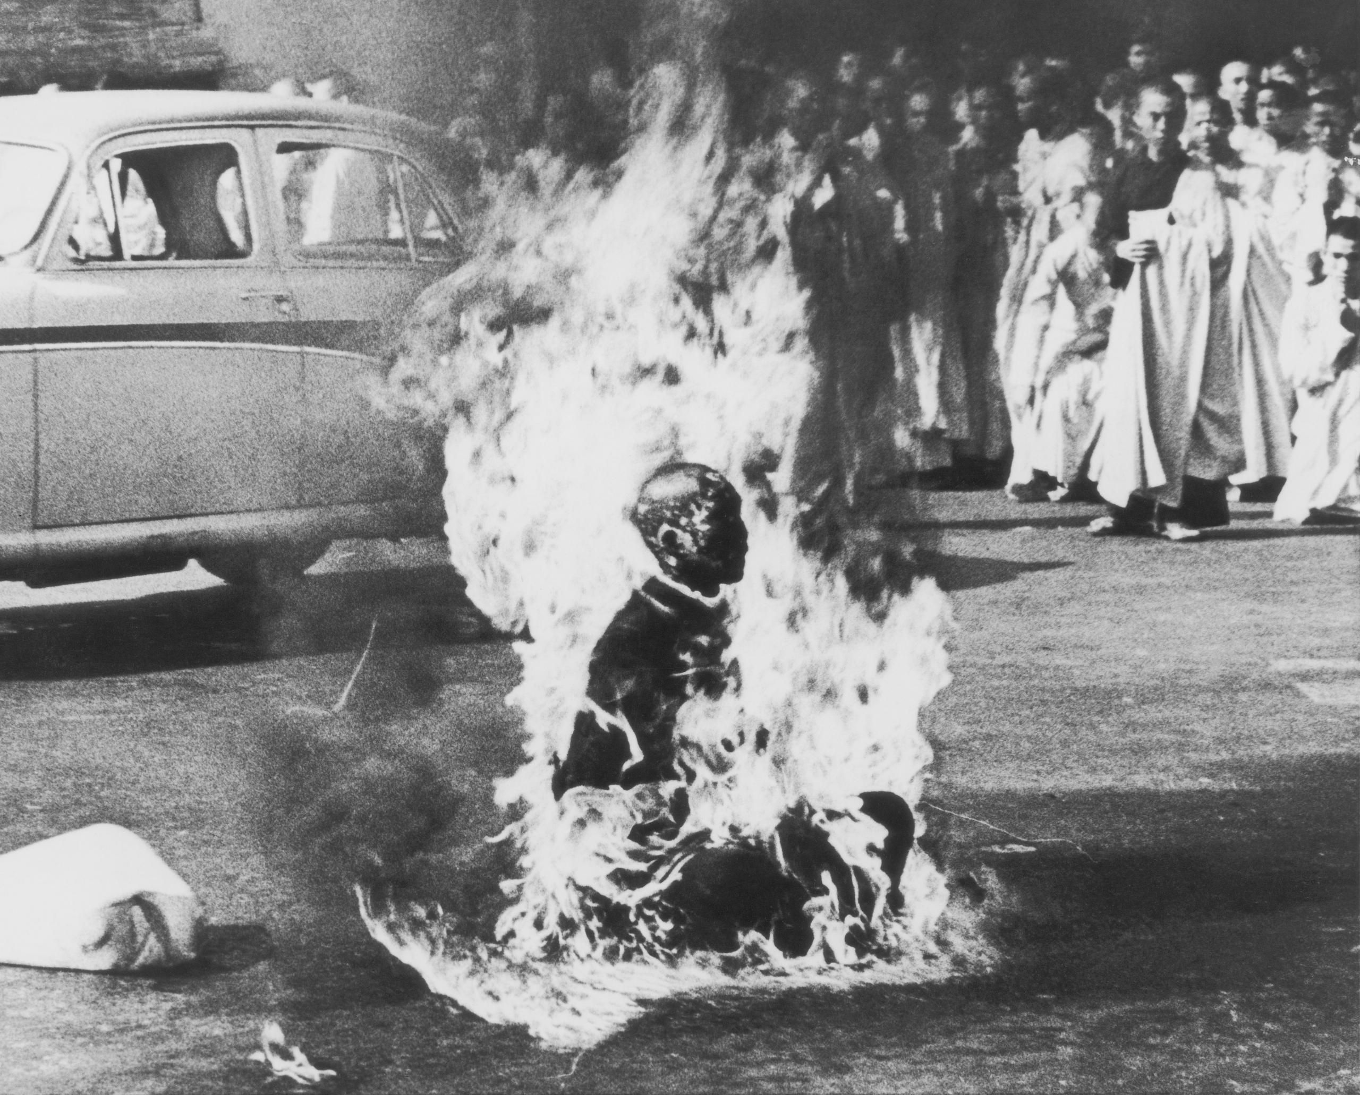
A PICTURE IS WORTH...

Slide 23
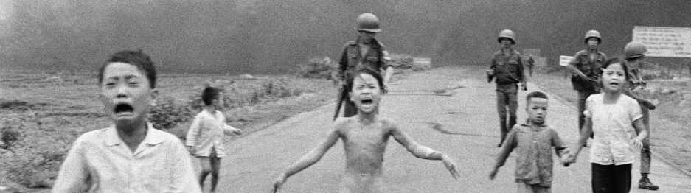
... A THOUSAND WORDS
“The Terror of War” Nick Ut/Associated Press.

Slide 24
MAINTAIN FOCUS

Slide 25
WHAT FOCUS?

Slide 26
WHAT FOCUS?
Not the slideshow.

Slide 27
WHAT FOCUS?
Not the slideshow.
Not you.

Slide 28
WHAT FOCUS?
YOUR MESSAGE!

Slide 29
WHAT FOCUS?
There is no
“u” (you)
in “slideshow.”

Slide 30
REMEMBER
GUIDELINES
NOT
RULES

Slide 31
GOOD LUCK!

